Slide 1
Blockchainification Updated 28 January 2020

Slide 2
How do we facilitate secure, honest and transparent interactions in a digital economy?

Slide 3
First a history lesson…

Slide 4
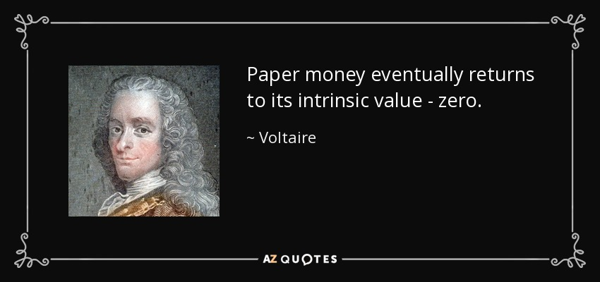

Slide 5
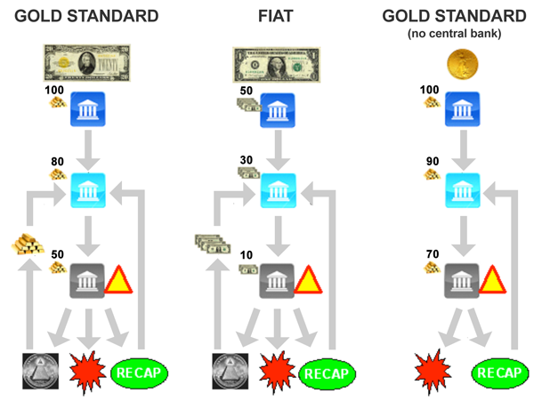
Deficiencies of the FIAT currency scheme
Coercion.
Rent Seeking
Central Planning.
Counterparty Risk.
Corruption.

Slide 6
Quis custodiet ipsos custodes?

Slide 7

A decentralized money scheme?
According to legend, Satoshi Nakamoto began working on the bitcoin concept in 2007.
October 31, 2008. Nakamoto publishes a design paper on “a Peer-to-Peer electronic cash system”.
January 3, 2009. Block 0, the genesis block, is established at 18:15:05 GMT.
October 5, 2009. New Liberty Standard publishes a bitcoin exchange rate that establishes the value of a bitcoin at US$ 1 = 1,309.03 BTC.

Slide 8
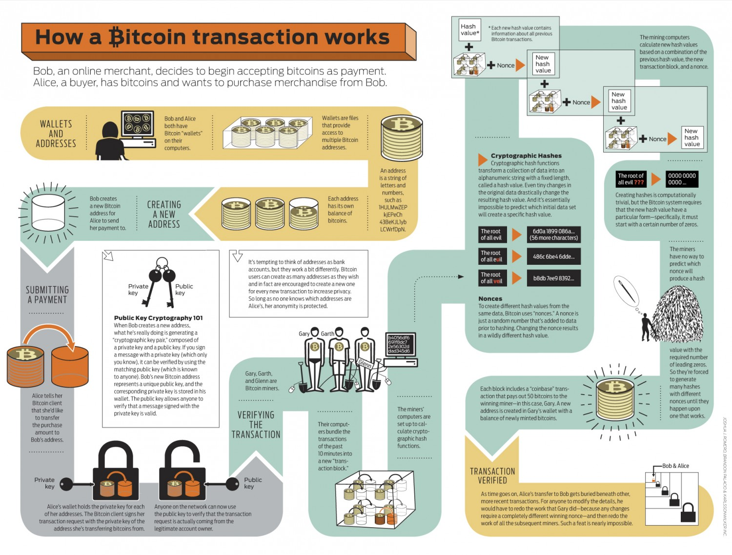
https://en.wikipedia.org/wiki/Bitcoin

Slide 9
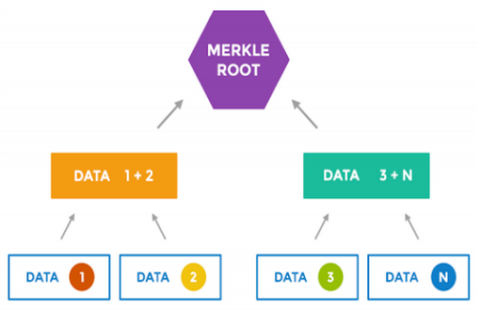
What can we learn from the bitcoin experiment?
Digital currencies could alleviate some of the deficiencies in the FIAT currency scheme.
New use cases emerge when we digitize our monetary systems and decentralize its governance.
Decentralized ledgers are a novel alternative to trust-based settlement systems and mitigating counterparty risk.
Consensus protocols are useful and still very much in their infancy.

Slide 10
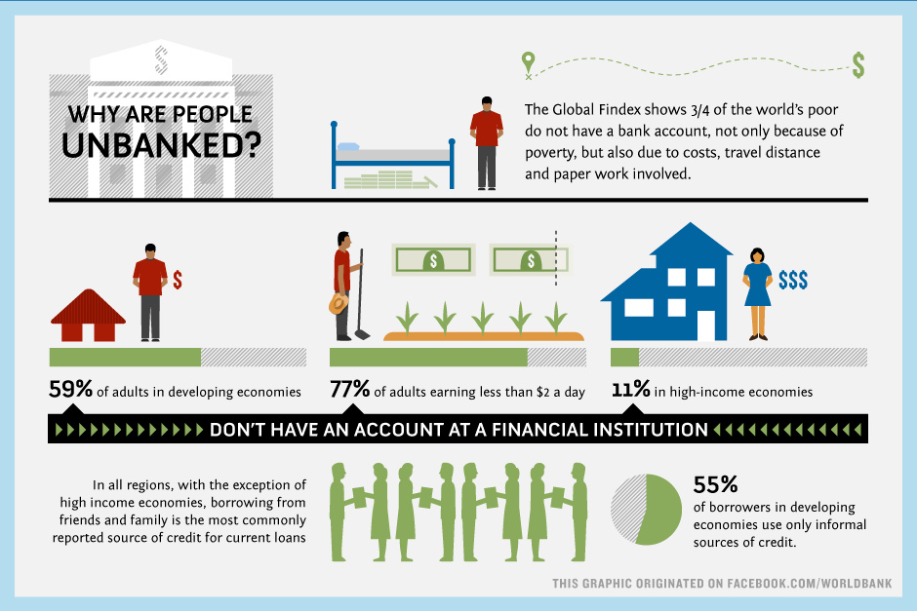

Slide 11
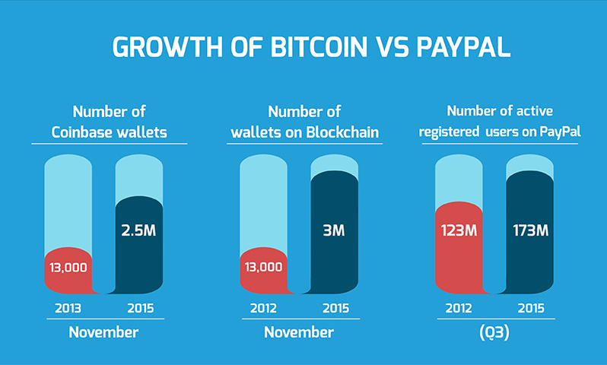

Slide 12
Enter the blockchain

Slide 13
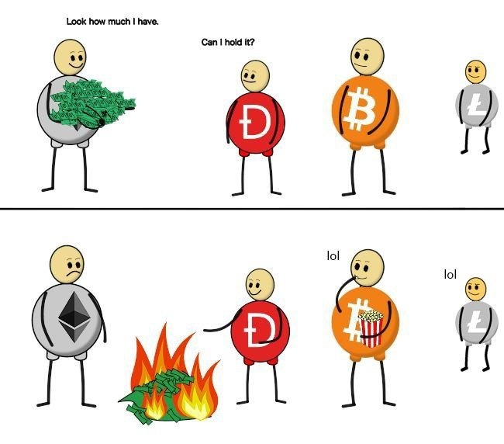

Slide 14
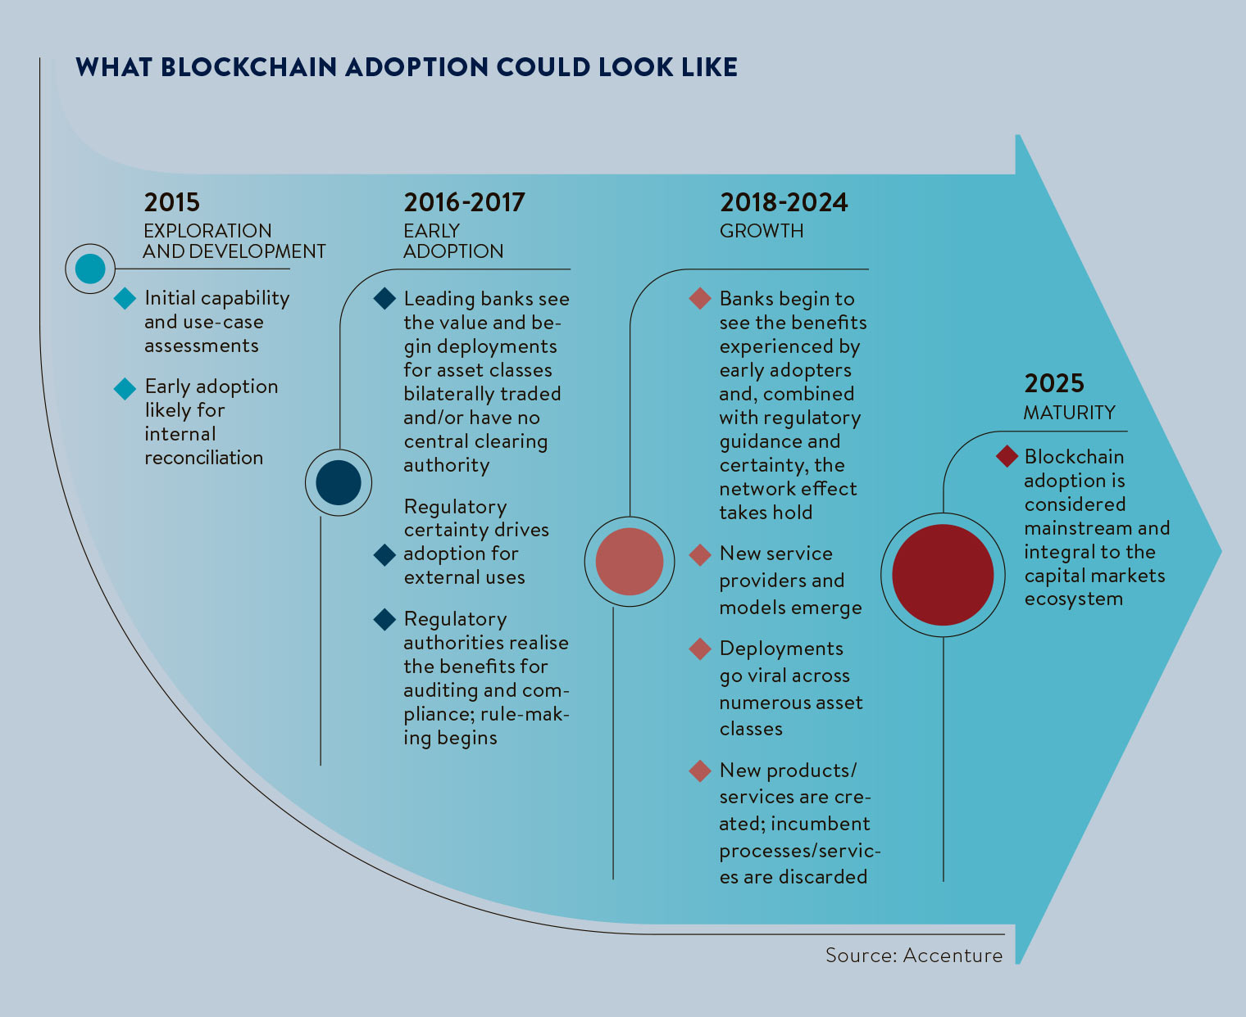

Slide 15
Autonomy of a blockchain

Slide 16
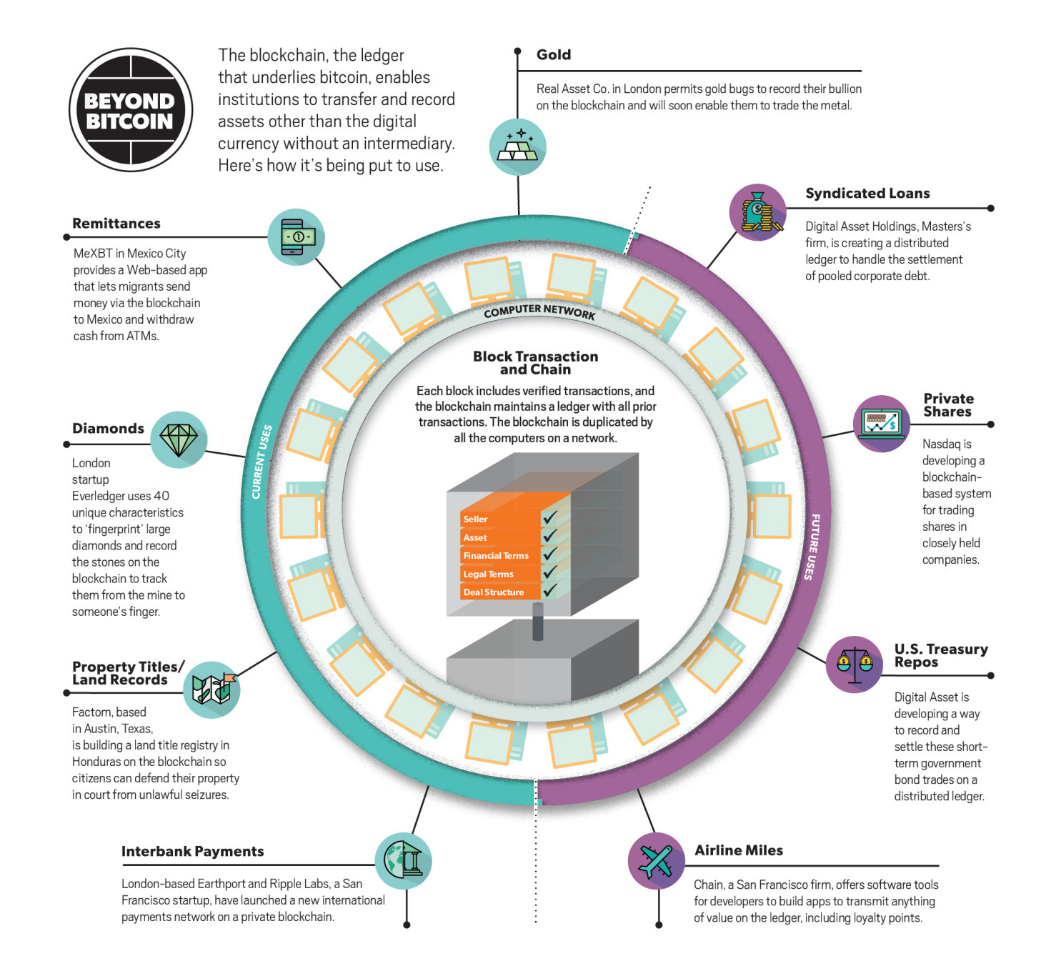

Slide 17
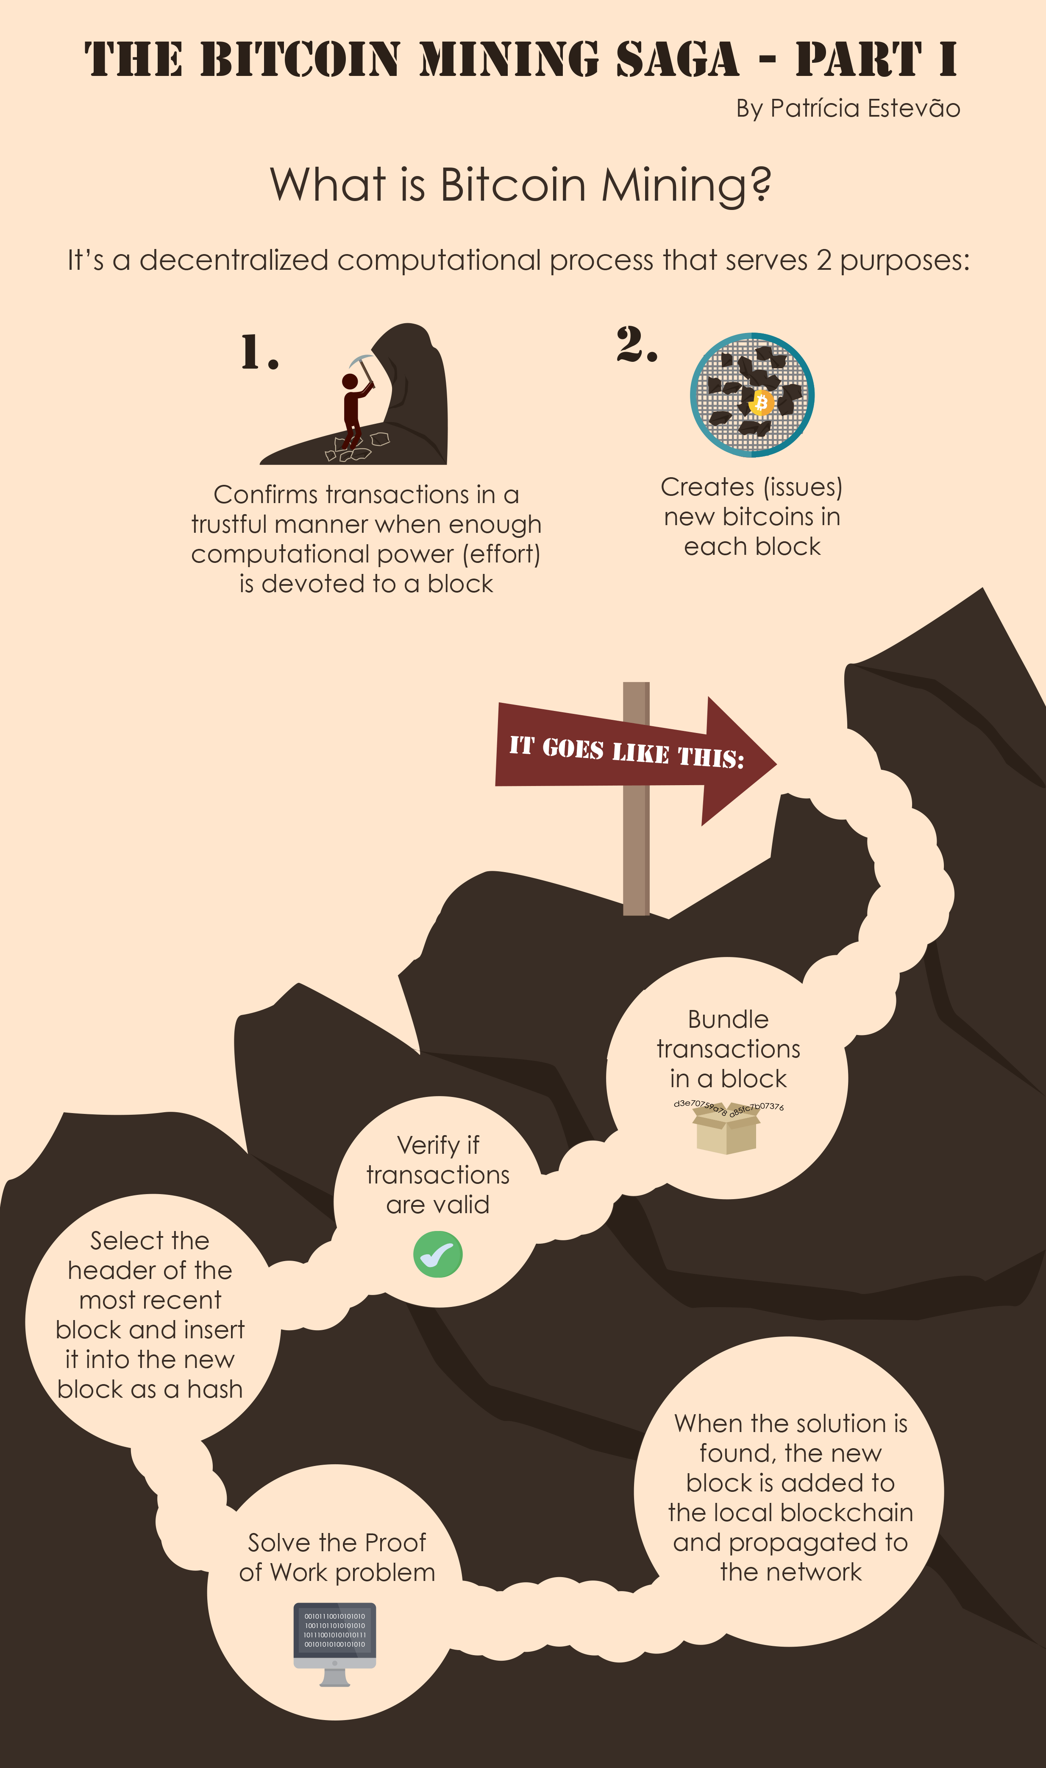

Slide 18
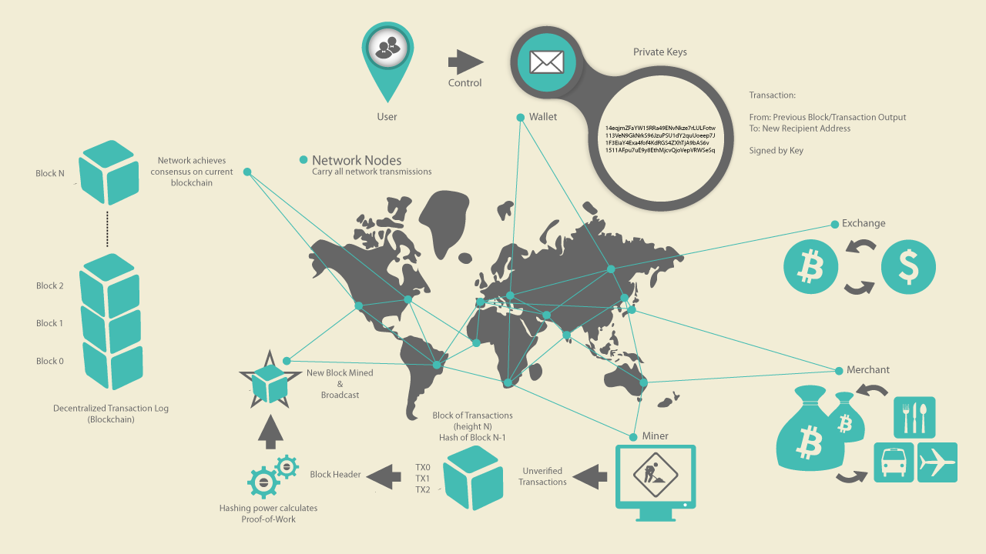

Slide 19
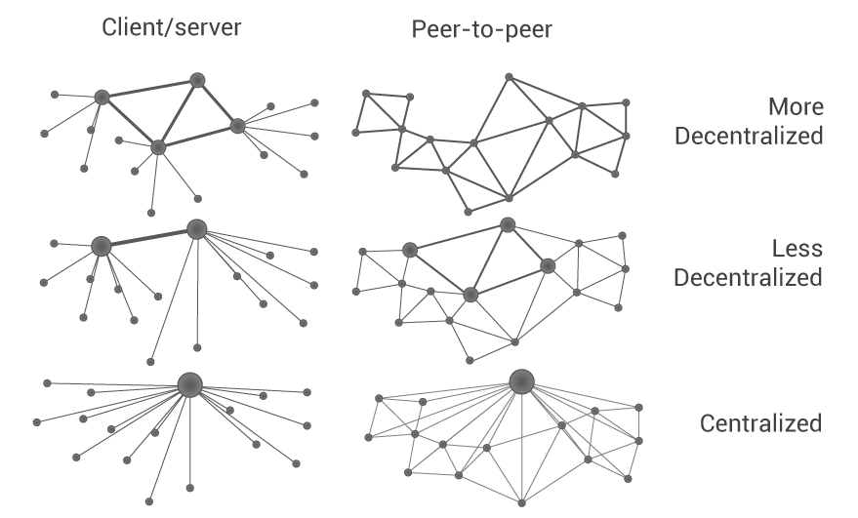

Slide 20
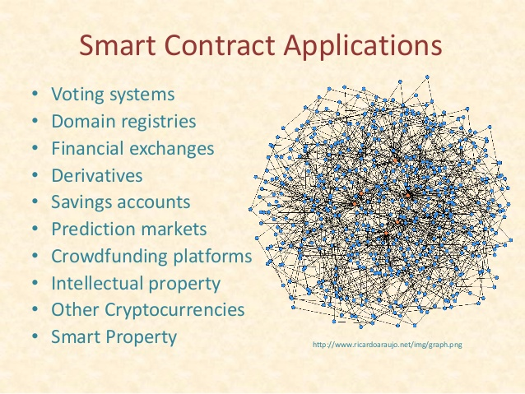
What are SmartContracts?
Theoretical: A computerized transaction protocol that executes the terms of a contract.
Practical: A very bad name for an “autonomous database trigger” that runs on a blockchain.

Slide 21
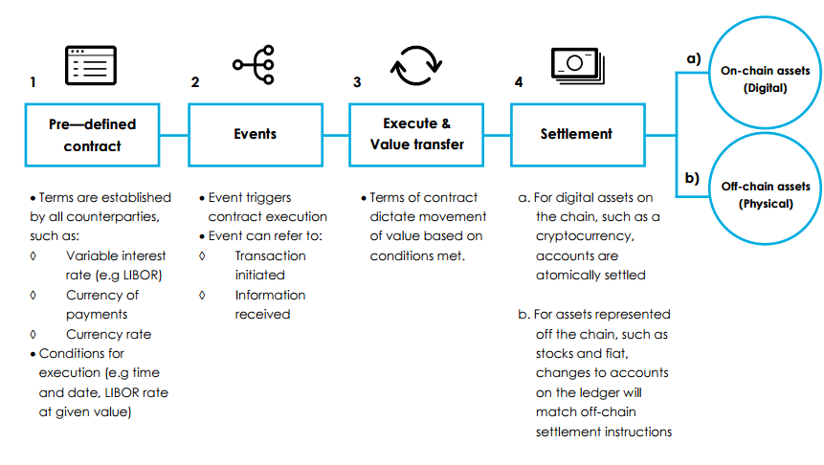
How are SmartContracts IMplemented?

Slide 22
What are some of the key success drivers behind mainstream blockchains?

Slide 23


Slide 24
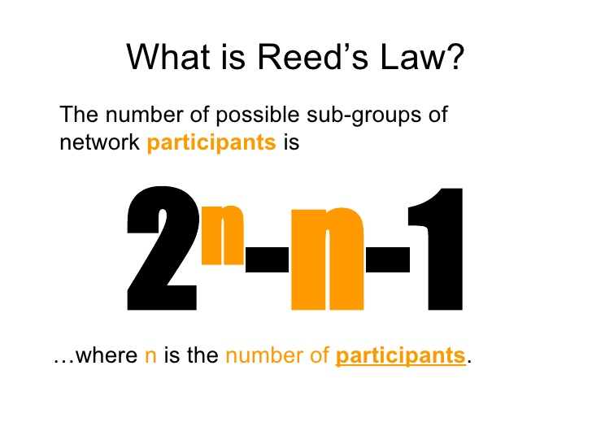

Slide 25
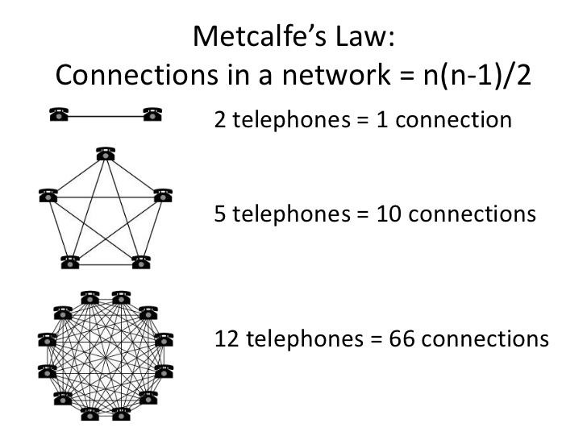

Slide 26
Why do we need blockchains?

Slide 27
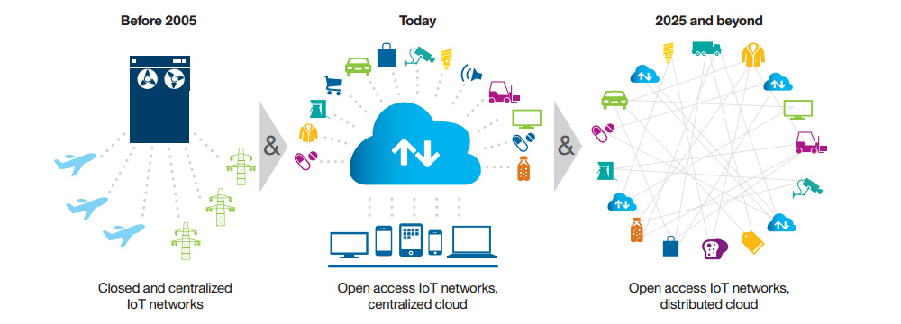

Slide 28


Blockchainification > Q/A

